Slide 1

Causality-Free Modeling of a Floating Wind Turbine Semisubmersible Platform with Validation Results
Doyal Sarker, Tajnuba Hasan, Tri Ngo, Tuhin Das
Department of Mechanical and Aerospace Engineering
University of Central Florida (UCF)
Presented by: Doyal Sarker
Mechanical and Aerospace Engineering
University of Central Florida
October 03, 2023

Slide 2

Presentation Outline
Background
Model Overview
Hydrodynamics Modeling
Results Validation and Discussions
Conclusion and Future Work

Slide 3
Background
Floating Offshore Wind Turbines (FOWTs)
Hydrodynamics modeling
CRAFTS: Control-oriented, Reconfigurable, and Acausal Floating Turbine Simulator
Modelica language for component-level modeling and simulation
Causality-Free Modeling
Plug and Play the component
Reuse and swapping
Independent direction of flow explicitly
Control-co-design idea

Slide 4
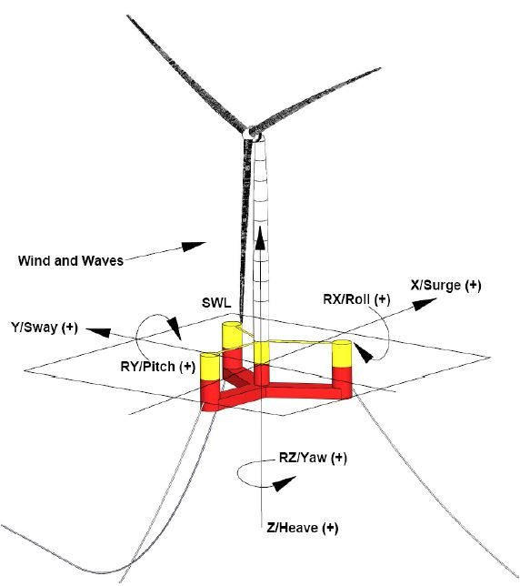
Model Overview
RNA
Tower
Optimized TMD installed in outer column (OC)
1DOF translation in vertical direction
VolturnUS-S reference floating platform [1]
Top level model in CRAFTS
[1] Allen, Christopher, et al. Definition of the UMaine VolturnUS-S reference platform developed for the IEA wind 15-megawatt offshore reference wind turbine. No. NREL/TP-5000-76773. National Renewable Energy Lab.(NREL), Golden, CO (United States); Univ. of Maine, Orono, ME (United States), 2020.

Slide 5
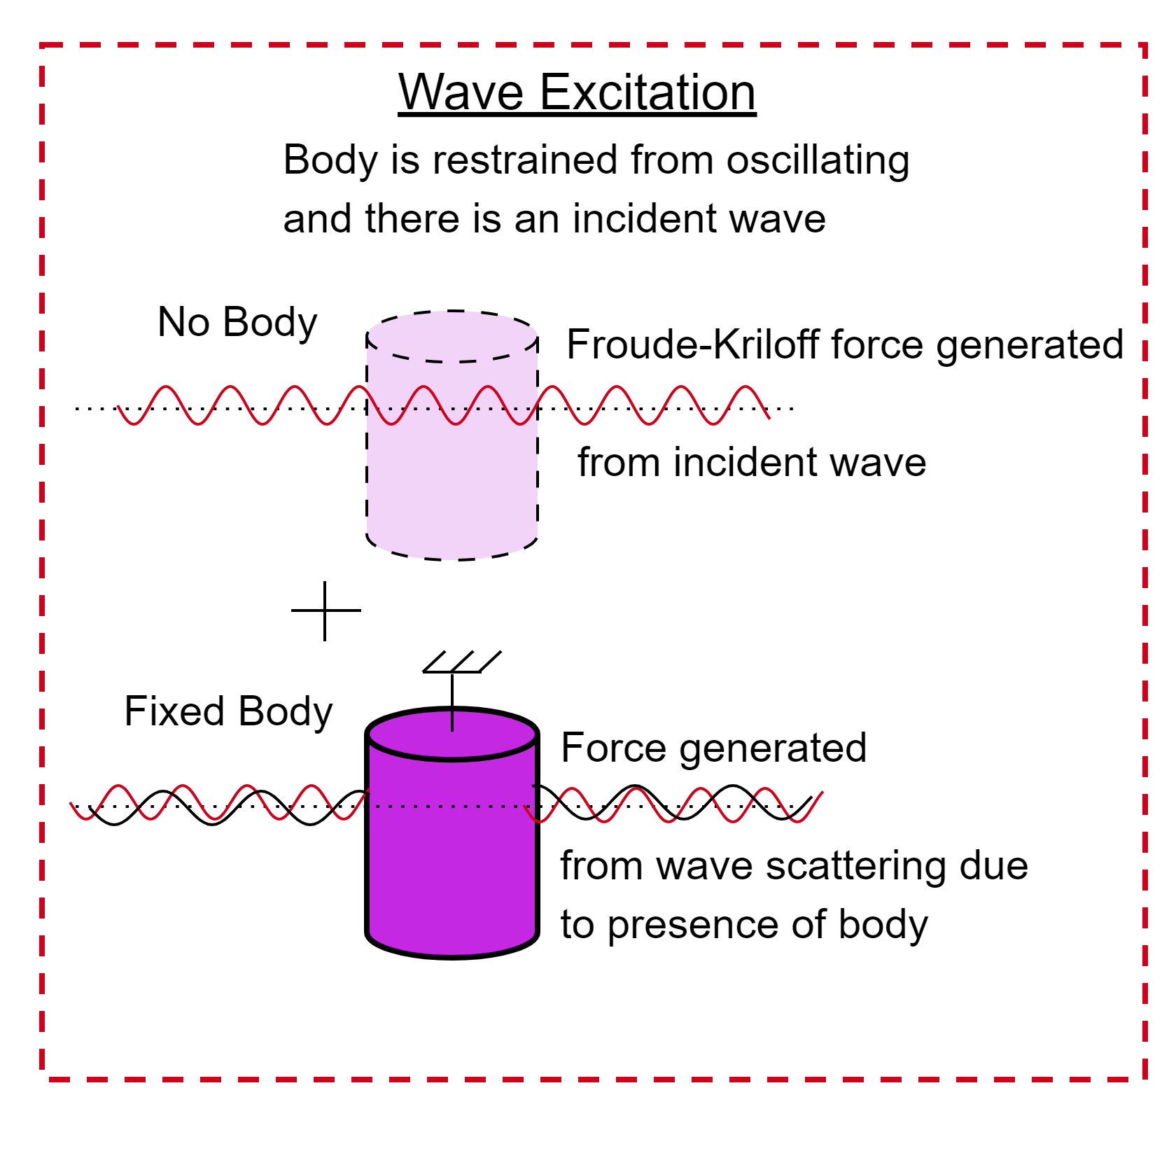
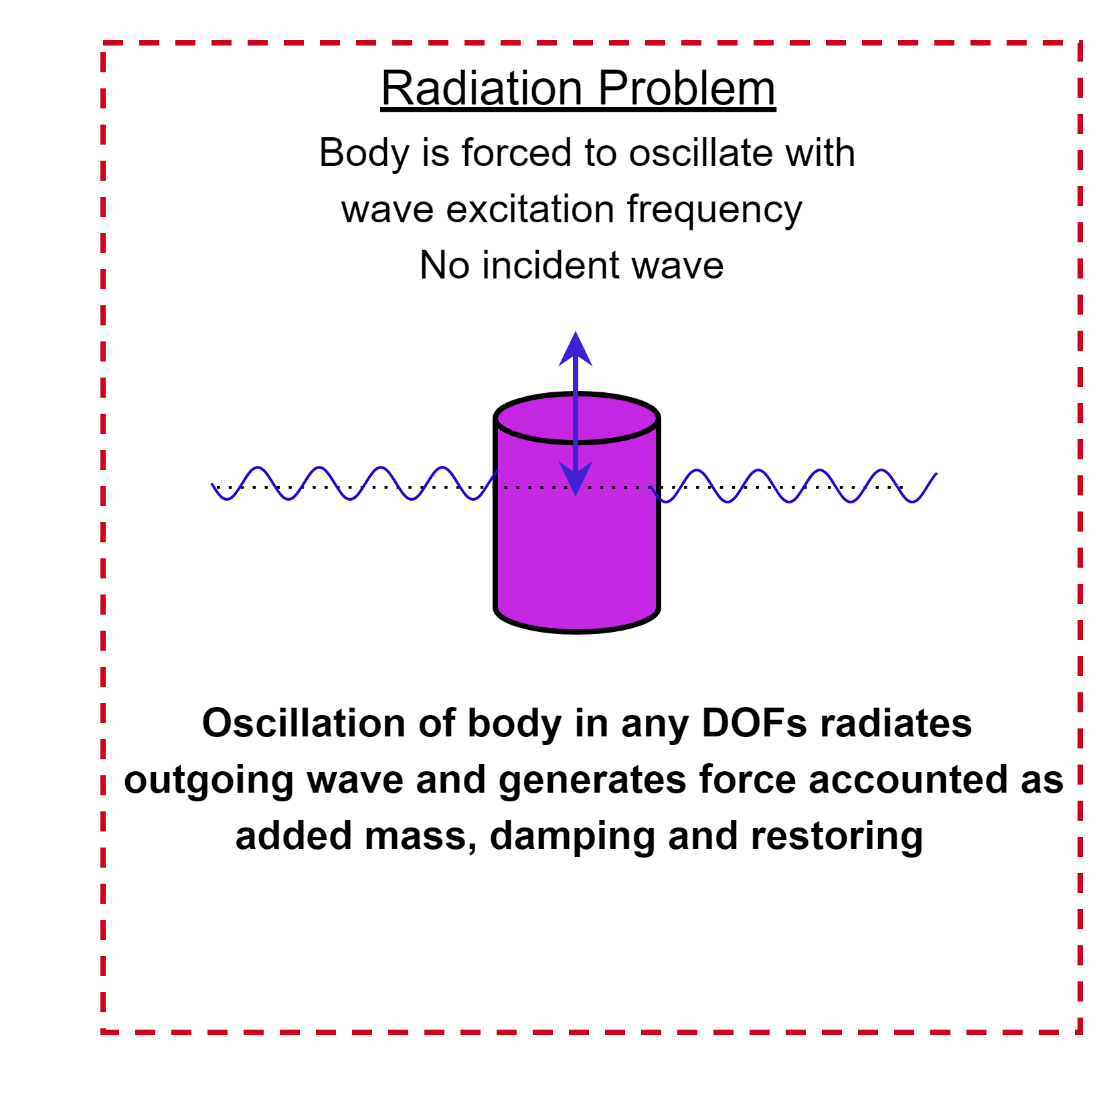
Hydrodynamics Modeling
Hydrodynamics Load
Potential Flow theory
Morison equation
Linear
Non-Linear
Excitation
Radiation
Viscous-Drag
Applicability:
D/L<0.2: Long wavelength approximation
KC > 2: Flow separation becomes dominant
D/L > 0.2: Diffraction becomes important
Wave-Excitation and Radiation problem [2]
[2] Viswanathan, Savin, and Christian Holden. "Modelica Component Models for Non-diffracting Floating Objects and Quasi-static Catenary Moorings." Proceedings of the American Modelica Conference 2020, Boulder, Colorado, USA, March 23-25, 2020. Liu Electronic Press, 2020.

Slide 6
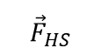
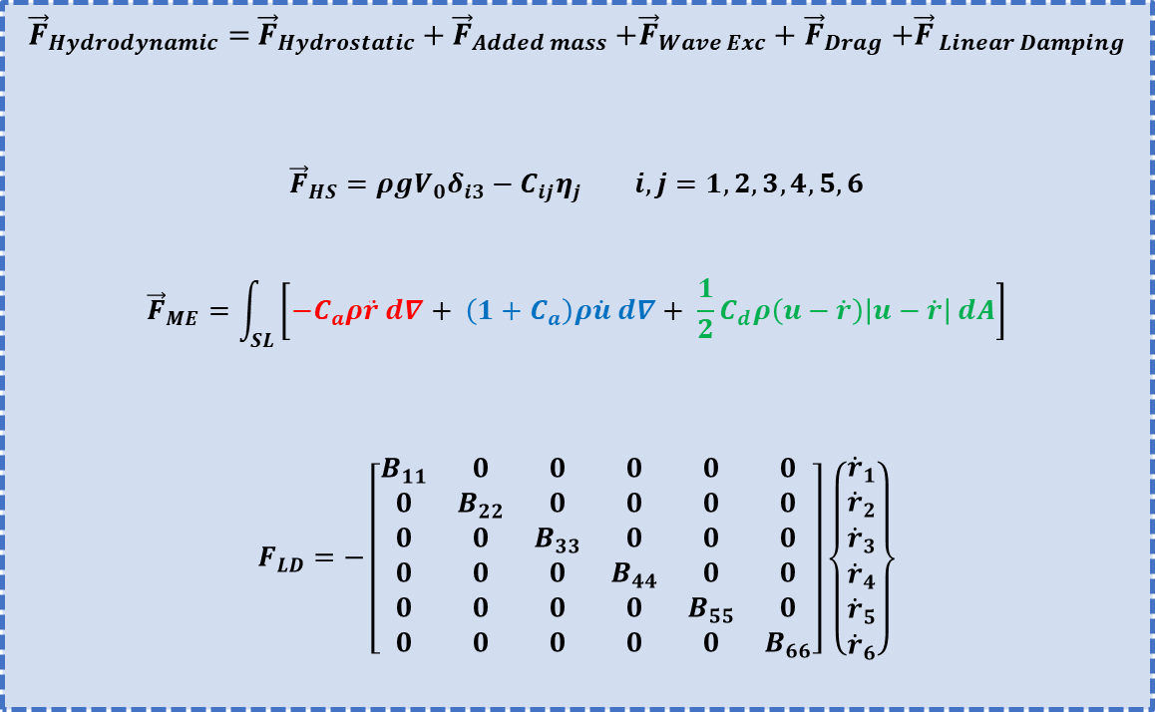
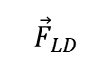
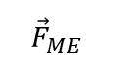
Hydrodynamics Modeling
Water depth
Water density
${\vec{F}}_{Hydrodynamic}=$ ${\vec{F}}_{Hydrostatic}+{\vec{F}}_{Added mass}$ $+{\vec{F}}_{Wave Exc}+{\vec{F}}_{Drag}$ $+{\vec{F}}_{ Linear Damping}$
$${\vec{F}}_{HS}=ρgV_{0}δ_{i3}−C_{ij}η_{j} i,j=1,2,3,4,5,6$$
$${\vec{F}}_{ME}=\int_{SL}^{ }{\left[−C_{a}ρ\ddot{r} d∇+ \left(1+C_{a}\right)ρ\dot{u} d∇+ \frac{1}{2}C_{d}ρ\left(u−\dot{r}\right)\left|u−\dot{r}\right| dA\right]}$$
$$F_{LD}=−\left[\begin{matrix}B_{11} & 0 & 0 & 0 & 0 & 0 \\ 0 & B_{22} & 0 & 0 & 0 & 0 \\ 0 & 0 & B_{33} & 0 & 0 & 0 \\ 0 & 0 & 0 & B_{44} & 0 & 0 \\ 0 & 0 & 0 & 0 & B_{55} & 0 \\ 0 & 0 & 0 & 0 & 0 & B_{66}\end{matrix}\right]\left\{\begin{matrix}{\dot{r}}_{1} \\ {\dot{r}}_{2} \\ {\dot{r}}_{3} \\ {\dot{r}}_{4} \\ {\dot{r}}_{5} \\ {\dot{r}}_{6}\end{matrix}\right\}$$
Floater 6 DOF responses, mooring tensions, tower motions in Time/Frequency Domain)
$${\vec{F}}_{HS}$$
$${\vec{F}}_{ME}$$
$${\vec{F}}_{LD}$$
Submerged Volume
Floating Structure
Wave Model
Added Mass
Wave-Exc
Viscous Drag
Body Kinematics
Iterative Process
[B] = Additional damping matrix
Instantaneous body kinematics
i,j = Surge (1), Sway (2), Heave (3), Roll (4), Pitch (5), Yaw (6); HS = Hydrostatic, ME = Morison Equation, LD = Linear Damping, SL = Submerged Length
$$\dot{r}, \ddot{r}=Body velocity and acceleration; u, \dot{u}=Wave velocity and acceleration$$
$$C_{a}, C_{d}=Added mass and Drag coefficients$$
$$d∇, dA=Displaced volume and projected area in the direction of wave propagation$$

Slide 7
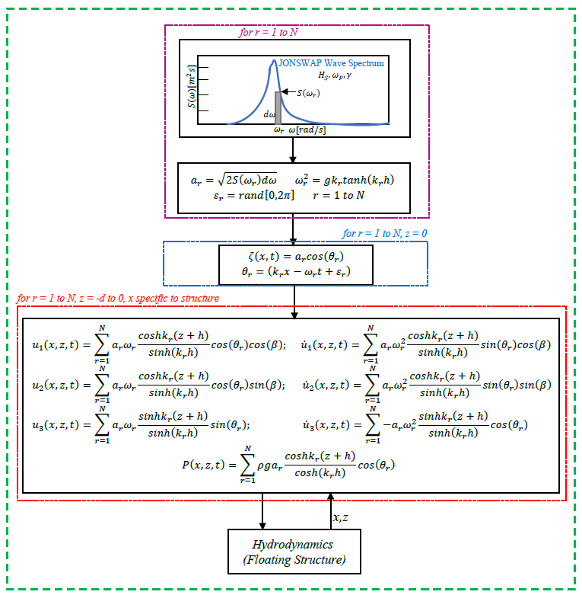
Wave Modeling and Assumptions
Linear Airy Wave Theory
JONSWAP Wave Spectrum
Hydrodynamics Assumptions
Small displacement approximation in hydrostatic load formulation
Added mass and drag coefficient don’t vary with water depth
Incident wave amplitudes are much smaller than the wavelengths
Irregular waves are modeled superimposing several linear regular waves.

Slide 8
Validation Results
Simulation Setup
Load Cases (LCs)
No aerodynamic loads
Global reference fixed at SWL
Water density 997.2 kg/m3
Water depth 350 m
Time step 0.05 sec
Column discretization, n = 100
Pontoon discretization, n = 10
Load Cases (LCs) |  |  | Wave Conditions
LC1.X | -- | Equilibrium | Still Water
 | 1.1 | Surge static offset | Still Water
 | 1.2 | Heave static offset | Still Water
 | 1.3 | Pitch static offset | Still Water
LC2.X | 2.1 | Surge free decay | Still Water
 | 2.2 | Heave free decay | Still Water
 | 2.3 | Pitch free decay | Still Water
LC3.X | 3.2 | Fixed TMD | Irregular Wave
 | 3.5 | Pitch TMD | Irregular Wave
 | 3.8 | Tower TMD | Irregular Wave

Slide 9
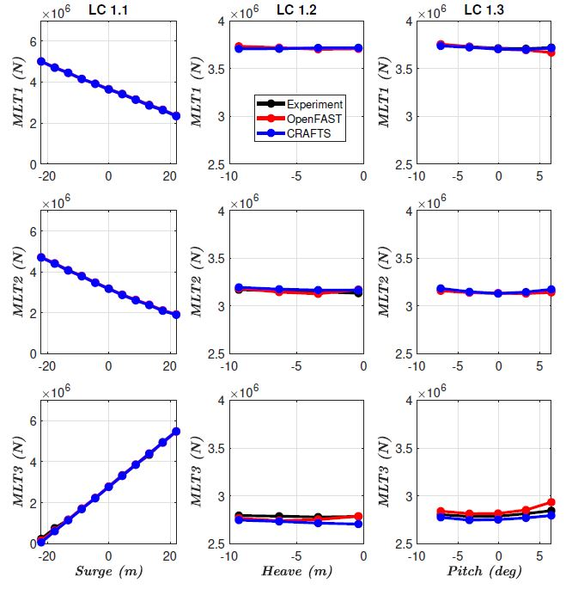
Validation Results
LC1.X (Equilibrium and Static offset tests)
DOF | OpenFAST | CRAFTS
Surge (m) | 3.19 | 3.19
Sway (m) | -1.97 | -1.97
Heave (m) | 0.02 | 0.02
Roll (deg) | -0.46 | -0.49
Pitch (deg) | -0.21 | -0.19
Yaw (deg) | 0.02 | 0.02
MLT: Mooring Line Tension
Prescribed position imposed in six DOFs.
Linear relationship

Slide 10
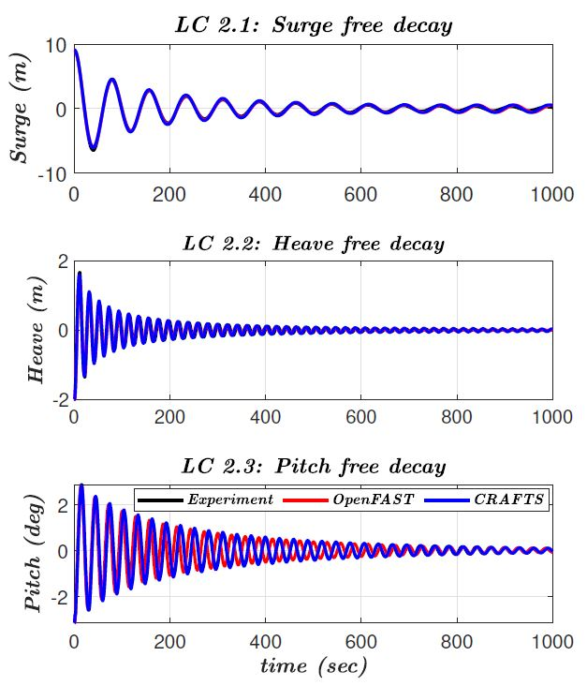
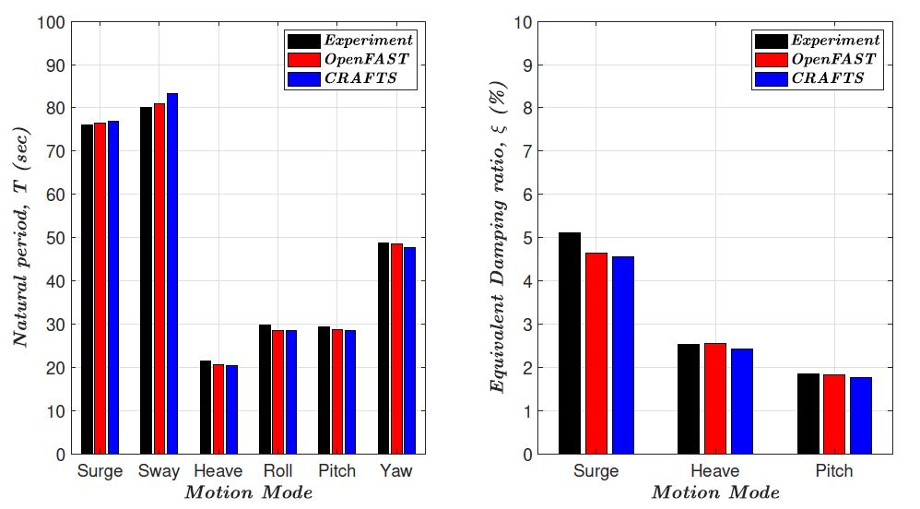
Validation Results
LC2.X (Free decay tests)
Natural Period Damping
Small phase shift in Pitch motion
Sway period: 4.14 % higher than experiment
Logarithmic decrement (Damping)

Slide 11
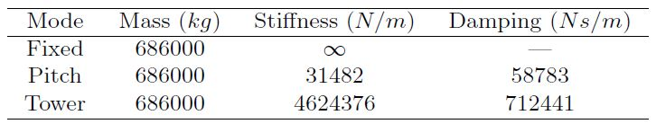
Validation Results
LC3.2 (Fixed TMD), Irregular Wave (Hs = 10.9 m, Tp = 14.2 sec, β = 0 deg)
Significant motions: Surge, Heave, Pitch
Analysis: Power spectral density (PSD)
Frequency (Hz)
Frequency (Hz)
TMD1 (Downwind, +Y)
TMD2 (Downwind, -Y)
TMD3 (Upwind, -X)

Slide 12
Validation Results
LC3.5 (Pitch TMD), Irregular Wave (Hs = 10.9 m, Tp = 14.2 sec, β = 0 deg)
$f_{Pitch}≈0.034 Hz$, TMD tuned to pitch frequency
 | Experiment | OpenFAST | CRAFTS
Pitch resonance | 19 % | 40 % | 26 %
Pitch TMD Strokes
Frequency (Hz)
Frequency (Hz)

Slide 13
Validation Results
LC3.8 (Tower TMD), Irregular Wave (Hs = 10.9 m, Tp = 14.2 sec, β = 0 deg)
$f_{tower}≈0.41 Hz$, TMD tuned to tower 1st bending mode
 | Experiment | OpenFAST | CRAFTS
Tower resonance | 65 % | 72 % | 78 %
Tower TMD Strokes
Frequency (Hz)
Frequency (Hz)

Slide 14
Conclusions and Future works
Developed a hydrodynamics module in CRAFTS library
Control co-design: controller and substructure were designed concurrently
Hydrodynamics module used strip theory-based Morison equation
TMDs were tuned to attenuate the platform’s pitch and tower bending resonance
Results were verified and validated against Experiments and OpenFAST results.
Focus on improving the hydrodynamics model accuracy
2nd order waves will be incorporated in the wave models
Real time spatial effect (Fluid-Structure Interaction) will be modeled properly
The floating platform will be integrated with actual wind turbine model
Active control needs to be incorporated.

Slide 15

Thank You

